Slide 1

Practising data science in the real world
Limitations and challenges
Dimitri Scronias, ORS PACA

Slide 2
What is this class about?
Make you think critically about data and statistical methods
Basics you should be able to do/think about as a statistician, data scientist, etc.
Issues and difficulties surrounding data you will encounter in your work
  Mainly targeted to people working directly on raw data…
  However, you can still benefit from it even if you won’t: everybody works using data at some point
Practical exercises using (mainly) dirty data
Notes:
Practical exercises using (mainly) dirty data: tell them that’s a problem and that working on toys dataset doesn’t prepare you to all the data manipulation you’ll have to do

Slide 3
How I made this class
Multiple books, which I reference throughout the course (have a look at them!)
My personal experience, stuff I wish I knew when I started working
Issues/problems I think you should be aware about as a DS/stat
  Though nobody will expect you to be experts on these subjects!
What I would like you to know if I were to interview you for a stat/DS position
Also, my goal is mainly to make you employable as a stat/DS, and give you a rundown of common challenges, possible solutions and good resources in a condensed format

Slide 4

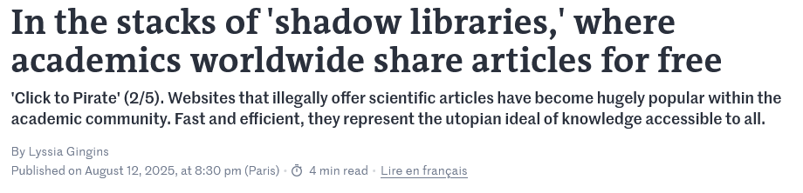
On the matter of books
Whenever I can, I try to reference free books that you can find online
Some of these are paid
Check this Le Monde article
  I’m not suggesting nor condoning anything
Notes:
It’s quite obvious, but paid books aren’t necessarily better than free ones.
Reminder: archive
Don’t mention any website name

Slide 5

Who am I?
2021–26 Assistance Publique – Hôpitaux de Marseille, ORS PACA
Soladis Group, ATIH
2019–21 Assistance Publique – Hôpitaux de Paris, ORS PACA
2021 DESU Data Science, AMSE
2019 M2 Economics – Economic Policies Analysis, AMSE
Notes:
Same background as you
Statistician/data scientist/whatever since 2019
Already taught this class for the two previous years

Slide 6

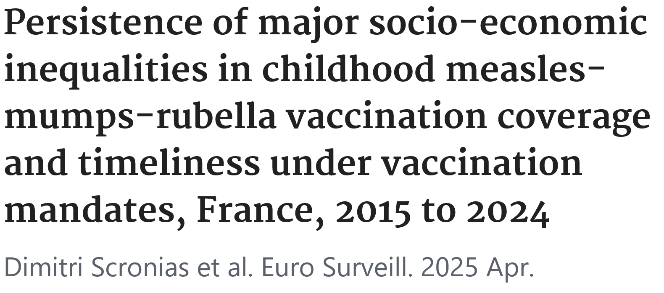
Stuff I have worked on
Vaccination
  Opinions and practices of healthcare workers
  (general practitioners, nurses, specialists) w.r.t.
  vaccination
  GPs’ recommendations practices of COVID-19
  vaccines
  Vaccine coverage and delays among French
  children
Emergency services’ quality of care, pressure, classification of diseases
Current big thing: soins non-programmés (unscheduled care)

Slide 7

Stuff I have worked on
Big databases:
  RPU + PMSI: all hospital and emergency stays in France
  SNDS: biggest healthcare database in France (possibly Europe), it contains all medical reimbursements, patient and physician data (+ other things) in the country. Some tables easily get billions of new rows every year

Slide 8

Internships (1)
I try to hire interns every year at the ORS:
  2024: 1 student from M2 MASS POP, for 6 months. Worked on an imputation methodology for the national emergency service datasets (RPU, ~20 million stays each year in France)
  2025: 2 DADEE students, for 6 and 3 months.
    One worked on writing a paper about a novel complexity scale for emergency stays based on ICD-10 diagnostics
    The other worked on the validation of an adequacy indicator for emergency stays using survey data among physicians in emergency services
  2026: nothing this year (too busy)
The internships always involve statistical work
Notes:
And probably other things that I have forgotten about

Slide 9
Internships (2)
Stats will be done using R (+ maybe a bit of SAS)
  This is non-negotiable (:
The complexity of the statistical work will vary
  It is very unlikely to involve heavy Machine Learning or Big Data
  Good opportunity to get a foothold in research
Other info:
  The pay is the legal minimum in France (~600€ a month?)
  It is very unlikely we will hire you after the internship (because no 💸)
  35h/week
  English is fine (it’s a plus if you can speak French so you can get along with the other colleagues)
  Location: Faculté de Médecine de la Timone, in Marseille
Notes:
And probably other things that I have forgotten about

Slide 10
Additional info on the course
Centered on:
  Tabular data
  Public health (with individuals as objects of analysis, mostly)
We’ll alternate between classes and labs where you’ll have to work on data
This class was supposed to have parts about data privacy, regulatory and legal constraints, etc…
  I don’t know anything about it, and I have no interest in that subject, so you’ll have programming exercises instead
Notes:
Still useful for you to know about data privacy, regulatory constraints, etc. It’s not a deal breaker if you don’t know about it, but the more you know…

Slide 11
Github/Final assignment
There is a GitHub here
  It contains all the class material, exercises, and some other material (like my resume in LaTeX if you want to reuse the code)
  I am likely to update a few things in the course content, check sometimes that what you have downloaded is up-to-date
Also, it contains the final assignment
  It’s a written report (code + report)
  + an oral exam
    I don’t have the time to actually see the 30 or so groups, I’ll just ask you to record yourselves
  Be sure to frequently check this document, I will add more information to it

Slide 12
Grading
Final assignment (15 points)
  Written report + oral exam
In-class labs (5 points)
  Lab 1 is just training
  Labs 2, 3, 4 are harder exercises: just send me two of them, they will be graded out of 5

Slide 13
Final assignment
In a nutshell, I want you to: find a messy dataset, find some business/research question, clean your data, create new variables, discuss potential biases in your data/model, present results
I am not very interested in complex ML methodologies, just:
  Critically think about what you are doing when you are cleaning your data (e.g. what might deleting data imply?)
  Try new things: different methodologies, models, see how your results vary
Ideally, I see this as a work you can show to potential recruiters

Slide 14





LLMs: my stance
For writing
I did not care about it and viewed it positively as long as it was used as an assistant
  Up until last year final reports and internship reports
There are telltale signs of AI writing: if you use LLMs to a point where I can’t be sure you have written your reports yourself or were totally freewheeling using Claude Max, it’s going to be a problem for me
For grading, I haven’t received any guidelines about what to do in case of overuse of AI in reports
Notes:
« Here is the conclusion to your report »
lol

Slide 15
LLMs: my stance
For coding
I am nicer about it, but I still notice in your work:
  Useless code with no purpose whatsoever
  Code too convoluted and needlessly complex to be actually written entirely by you (or by any human)
The worst case is when you copy code you don’t understand
Just know that, if I suspect most of your work in my class is generated using an LLM:
  I won’t recommend you
  I won’t consider you for an application

Slide 16

LLMs: obvious red flags
The last years were wild — and you know what? That’s rare. Here is the top 3 obvious mistakes you should avoid this year:
Including your conversation with your LLM inside your work
Writing your entire report AND your presentation only with AI
Stealing work, vibecoding over it, and presenting it to recruiters

Slide 17

Last advices before starting
For jobs in France, try the APEC: I was called 3-4 times a week for DS/biostatistics positions by recruiters when I posted my resume there
Check the average salary for your job on Glassdoor or the APEC, bump that by 10% when negotiating
If you want to train for interviews, go to job fairs and talk to literally everyone
  Remember you are trying to sell a product: yourself, a capable working professional
If your goal is to increase your salary quickly, don’t stay in the same company
Notes:
Check the average salary for your job on Glassdoor or the APEC, bump that by 10% when negotiating: worst thing they will say is no
Talk about my salary

Slide 18
Last advices before starting
There is my CV template on GitHub
  I made it a while ago using Latex
  You can reuse it or modify it, without attribution
I can review your resume
  Just ask me after class, if I’m not too busy
  Or wait until the AMSE Career Day

Slide 19
Questions?
I’ll answer questions about jobs, work experience as a data scientist, projects…
Don’t send me messages on LinkedIn, use my email address.
dimitri.scronias@univ-amu.fr

Slide 20
Summary
“So, can you tell me about the different steps in a data project?”
—Some recruiter (whose name I forgot)
Notes:
ASK STUDENTS WHAT THEY THINK

Slide 21
Summary
Data & defining needs
Data manipulation & cleaning
Missing data & imputation, data quality and reliability…
Modelling
Bias and fairness, interpretability and explainability, scalability and performance
Communicating results
Communication and collaboration
Plus: programming exercises in-between

Slide 22


Data & defining needs

Slide 23
What we’ll see
Defining data and data science: what it is, what it is not
Planning your analyses:
  Doing a data analysis plan
  Data types
  Modelling strategies
  Pre-hoc variable selection
  Tools and software

Slide 24
Resources
Simon Thompson. 2023. Managing Machine Learning Projects: From design to deployment
Provost F., Fawcett T. 2013. Data Science for Business: What you need to know about data mining and data-analytic thinking (2013)
Ameisen, Emmanuel. 2020. Building Machine Learning Powered Applications: Going from Idea to Product

Slide 25
🌈Data science🌈 What? Why?
DS involves “principles, processes and techniques for understanding phenomena via the analysis of data” (Provost F., Fawcett T.)
Main goal: help decision-making (Data-Driven Decision Making)
Avoid uninformed decisions like “we have always done it this way”, counterproductive “intuitive decisions”, or sometimes plain stupidity or dangerous decisions.
Notes:
Ask students what data science is

Slide 26
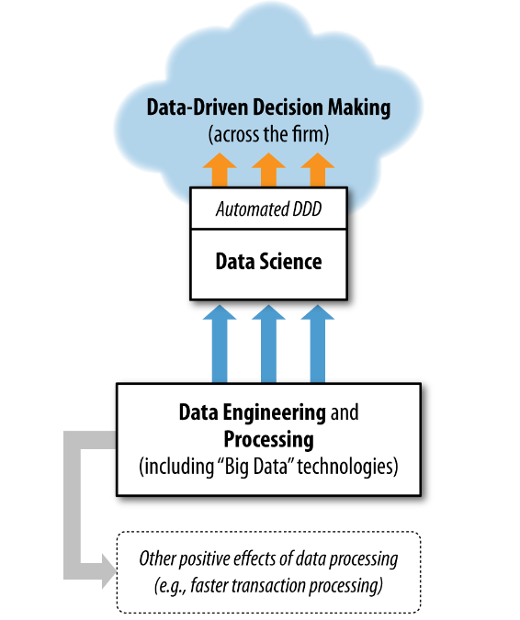

🌈Data science🌈 What? Why?
Very simplified model of the goal of DS in a firm
DDD associated with increase in productivity in a firm
Keep in mind sometimes DS is not used for decision making! (but that is what we will focus on)
This graph is… not great. It is disconnected from reality. More on that in a dozen hours.
Provost F., Fawcett T. Data Science for Business.

Slide 27

🌈Data science🌈 What? Why?
POLL TIME
Between these three data science tasks, which do you think is most important? (only one answer)
a. Data cleaning (restructuring, data accuracy…)
b. Analysis (modelling, deriving knowledge…)
c. Communicating (results, interpretation…)
Which do you think is the most neglected?
Notes:
I actually have no answers to this, I was just curious

Slide 28
Don’t forget the end goal
Your job is to make data interpretable for decision-makers to make informed, data-driven decision. The goal is the decision-making and not the analysis itself.
Remember, you will be dealing with people that:
Do not understand statistics as well as you;
Will be focused on getting results.
Learn to simplify complicated findings from data
Notes:
Does not understand statistics as well as you: that will be something new for you when you get into your new job. You now might be one of the most knowledgeable person about stats/economics/other where you work at (except for seniors).
The end goal is this. Not fancy models. Not LLMs. Not AI. Not idk what. Even though most data science courses are about complicated modelling.
Doing data science is useless if you can’t communicate your findings clearly
Not the analysis itself: unless you are doing research, of course. But usually, even research ends up being used for political decision making.

Slide 29
🌈Data science🌈 What? Why?
Data. Use one word to describe it.
Here is a table:
name | body_temperature | location
Térébenthine | 37.5 | mouth
Gonzaguette | 37.3 | mouth
Arlette | 36.4 | armpit
Henri-Clotaire | 48.5 | forehead
Jehanne-Bertrude | 39.1 | mouth
Quick question, raise your hand for yes:
a. Is this data?
Notes:
Yes

Slide 30
🌈Data science🌈 What? Why?
“Factual information (such as measurements or statistics) used as a basis for reasoning, discussion, or calculation”
— Merriam-Webster
“The word ‘data’ is commonly used to refer to records or recordings encoded for use in computer, but is more widely used to refer to statistical observations and other recording or collections of evidence”
— Zins C. (2007). Conceptual approaches for defining data, information and knowledge.
Defining (and understanding) data is a lot harder than it seems. The article above contains more than 40 definitions of it.
Notes:
WHAT DO YOU THINK DATA IS?

Slide 31
Data as fact
name | body_temperature | location
Térébenthine | 37.5 | mouth
Gonzaguette | 37.3 | mouth
Arlette | 36.4 | armpit
Henri-Clotaire | 48.5 | forehead
Jehanne-Bertrude | 39.1 | mouth
The Merriam-Webster defines data as factual information
b. Is the second column a fact?
A fact is a concept in ontology, it is just “what is”.
  A fact is not true or false. It exists or does not exist.
Evidence (data structured and interpreted) is used to evaluate whether a statement about a fact holds true (it is epistemological)
A datum is an entry, its purpose is rhetorical
Data is independent from facts. « When a fact is proven false, it ceases to be a fact. False data is data nonetheless. »
Notes:
Ask if they know what a fact is?
A data is NOT a fact. Data can be a fact, but these are two distinct concepts.

Slide 32
🌈Data science🌈 What? Why?
name | body_temperature | location
Térébenthine | 37.5 | mouth
Gonzaguette | 37.3 | mouth
Arlette | 36.4 | armpit
Henri-Clotaire | 48.5 | forehead
Jehanne-Bertrude | 39.1 | mouth
Quick questions, yes or no.
b. Is the second column body temperature?
Notes:
It’s not “the” temperature of the body, but a recording at some point in time, in a specific location, whereas temperature is more of a continuous, dynamic process of the body, with different values throughout the body (probably)

Slide 33

Data lifecycle
🌈Data science🌈 What? Why?
1. What is it?
2. Is it data?

Slide 34
Data lifecycle
🌈Data science🌈 What? Why?
La trahison des images,
René Magritte
One of the points of the painting is that this is not a pipe, but a painting of a pipe. A representation.
Is it a pipe?
If it is not, what is it?

Slide 35

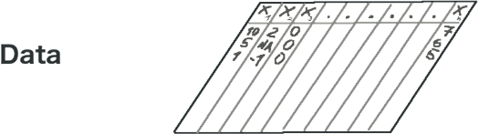
Data is a representation
Seems like a needless distinction, but you never properly acknowledge it:
The real world is what you are interested in
  Problem: you will never observe it directly
Data is not the real world but a representation of it
  Many mediums: photographs, audio recordings, tables, writing, drawings…

Slide 36
🌈Data science🌈 What? Why?
name | body_temperature | location
Térébenthine | 37.5 | mouth
Gonzaguette | 37.3 | mouth
Arlette | 36.4 | armpit
Henri-Clotaire | 48.5 | forehead
Jehanne-Bertrude | 39.1 | mouth
Column 2 was gathered using a thermometer.
d. Is this column objective?
e. Is this an accurate representation of the temperature of the body?
Notes:
d,e) “Objective” = free from bias. This can be questionable. Can you really compare temperature taken at different locations? Can it vary? Plus, is the instrument properly calibrated? We have someone with a body temperature of 48.5 degrees. Plus, different definitions and ways of measuring temperatures (Celsius, kelvins, fahrenheit…). Perhaps different physical ways of measuring temperatures.
We tend to think measurement taken by machines or automated processes as more “objective” that other sources of data, but it can be very misleading.

Slide 37
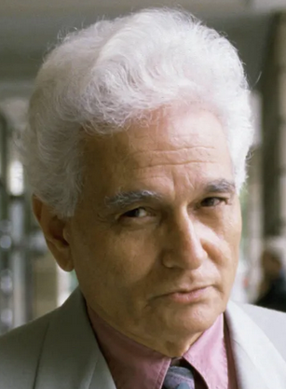

Data déconstruit
Data comes from Latin “dare”, “to give”.
“Data are (or datum is) an abstraction. I mean, the concept of ‘data’ or ‘datum’ suggests that there is something there that is purely given and that can be known as such. […] There is nothing like ‘the given’ or ‘naked facts’ but that every (human) experience/knowledge is biased.”
— Zins C. (2007). Conceptual approaches for defining data, information and knowledge.

Slide 38
Data déconstruit
In easier terms, data is not only a representation of reality (what we saw a few slides before), but also an interpretation of reality that is always biased
You will find researchers who argue that data does not exist

Slide 39

Data as an interpretation
I think analysing an image is a bit like tabular data analysis (you just use different tools).
Is it data?
What does this data represent?
What is the color of the two characters jackets?
What is the person on the right holding?
Is one standing higher than the other?

Slide 40
Data as an interpretation
Who is the character on the right?
Who is the character on the left?
Who is the person behind the camera?
Where are they?
What is the relationship between the two characters?
Data is always an incomplete representation of reality. An image can’t tell you what characters think, how they relate, what is outside the frame, while it is still important in order to understand the whole scene.
Notes:
2003 photo, in Iraq. US soldier and a Iraqi prisoner.

Slide 41
Raw data
The image was taken straight from a camera, without modification.
Is this data “raw data”? (i.e. data that is unprocessed, as close to reality as possible)
“Raw” data is misleading
Raw does not mean accurate, free from bias or free from human decisions
Raw data from a camera (or sensors, in general) is also an interpretation of reality:
Colours depend on the camera colour science and lens
Infrared and ultraviolet light is (typically) cut off
Resolution is limited, you cannot zoom as much as you want
Proportions vary depending on the focal length of the lens

Slide 42
Data as an interpretation
How and what data is recorded is always dependent on human decisions, processes, techniques…
For data created by humans (surveys, manual input), it’s easy to see potential errors and pitfalls
When data is automatically gathered (through automatic procedures, software, machines, sensors…), we tend to see it as more truthful or accurate
  Very misleading! We decide how this data is created and stored
  This gets dangerous when we don’t know or understand how this data is created and interpreted by the machine (you probably look at images everyday, do you know how cameras work?)
  Hardware and software are prone to errors and bugs too
Notes:
Complacency and bias in human use of automation: an attentional integration
https://pubmed.ncbi.nlm.nih.gov/21077562/

Slide 43
Data as an interpretation
A dataset is also an interpretation: it contains what is considered relevant to analyse a phenomenon.
“Some elements are privileged by inclusion, while others are denied relevance through exclusion” (Travis D. Williams, Raw Data is an Oxymoron)
Similarly, the framing of this picture is what was deemed relevant by the photographer to capture the scene.
Notes:
Complacency and bias in human use of automation: an attentional integration
https://pubmed.ncbi.nlm.nih.gov/21077562/

Slide 44
Data as an interpretation
MISSING DATA
There is missing data in this picture.
Does this change your interpretation of the scene?
You uncovered the missing data.
Does this change your interpretation of the scene?
Notice how you interpretation might change between: unknown missing data, known missing data, “full” (?) data (it’s the same with tabular data)
Notes:
Missing data = relevant information!

Slide 45

There is one question you NEVER ask yourself
Why
name | body_temperature | location
Térébenthine | 37.5 | mouth
Gonzaguette | 37.3 | mouth
Arlette | 36.4 | armpit
Henri-Clotaire | 48.5 | forehead
Jehanne-Bertrude | 39.1 | mouth

Slide 46
Why does the data exist?
ASK YOURSELF THIS QUESTION (you never do and this makes me mad)
Why is the data gathered in the first place?
We don’t gather data for fun, it is done with a purpose in mind and within a context
It is very different to analyse data gathered for administrative purpose (healthcare data, financial data, police reports…), or for specific research projects
Also depends on who gathered the data (independent pollsters, researchers, administrations, police…)
Data has a social, cultural, economic and political context

Slide 47
Why does the data exist?
What can you ask yourself?
Who collected the data? For what purpose? Does this align with the question I want to answer with this data?
Is there data that was NOT gathered that could be relevant to my work? People that were excluded? Omitted variables?
Were some variables considered more important than others? How rigorous was the collection?
Are there incentives in the data collection process? Do they favor some data over others?
Given the exact same data collection methodology, does the data carry the same meaning over time? Does it change?
Notes:
All of these are questions I have had to ask myself.
SNDS.
Always happen. People that were too difficult to access. Variables too difficult to get. Or were out of scope, or initially deemed not relevant.
Data quality. Sometimes the data collection is of poor quality. Or people just cant be bothered to do a good job.
Very bad. Example of emergency services.
ALL THIS INFORMATION IS NOT IN THE DATA. YOU NEED TO DO RESEARCH AND ASK PEOPLE.

Slide 48

Data as capta
Johanna Drucker (researcher in digital humanities) talks of capta: “Data are capta, taken not given, constructed as an interpretation of the phenomenal world, not inherent in it.”
Also: “Data are never neutral, but always constructed from some point of view, with a specific set of values and beliefs.”
Check out The Digital Humanities Coursebook, which offer a fresh perspective and counterpoint to typical data science courses (+ Raw Data is an Oxymoron + All Data Are Local: Thinking Critically in a Data-Driven Society (I haven’t check it yet))
Notes:
What does it mean? Data, as we usually think of it, does not and cannot exist. It is not something that exist in the world, that is a perfect representation of reality, and that you just take. It is something that you build, it is an interpretation because we choose what data (capta) to select, measure and record them. You imagine it first, before it exists.
Analysis of the classroom. Lot of information. If I wanted to do an analysis, I choose the research question, I choose what data to collect, what variables are relevant, and how to record them.
Drucker 2011: https://dhq.digitalhumanities.org/vol/5/1/000091/000091.html

Slide 49
“Data” takeaway
You already have a sense of some data being “good” or “bad”, that it may require “cleaning”, and thus that data should be questioned
However, you keep thinking of data as the first step in all your projects, while it comes much later: there are first your phenomena of interest, how, why and what you (don’t) collect, and how correct this representation is (hence, why we talk about capta)
  These are supplementary sources of errors and misinterpretations
In the end, while contextualisation matters, you still need to make do with what you have: data will always be imperfect

Slide 50
I. Defining needs

Slide 51

Back to business
Let’s stop philosophy for now and focus on more practical things
As a data worker, your projects always start with a query, by a client, product owner, boss...
First task you will do on any new project: planning.
Bernard, 1968 HEC graduate
Tip
As soon as you get your first job, keep in mind you are the specialist who knows how to make data talk (and no longer a student). This is also applicable to your interviews.

Slide 52
Planning analyses (1)
Good practice: prepare a data analysis plan (a roadmap)
What to plan: data collection, variable selection and modifications, imputation, weighting, which models, etc. etc.
Choosing the right tools (e.g. programming language) is also more important than you think
Did you know?
Sometimes (in clinical research for example), all analyses must be planned.
If you decide to change even one thing, you must discard the data and start everything from scratch.
Notes:
Note: I won’t give a specific layout for this, you do whatever you want. It’s just suggestions, and what I do personally

Slide 53
Planning analyses (2)
In some jobs, a data analysis plan may be a requirement (in this case, you have a predetermined layout to follow)
If not, you should put:
  Data collection methodology
  Quick description of the metadata: variables, their types, how many observations, are there clusters, is it a sample or administrative data…
  The question you are trying to answer
  Software/languages you are going to use
  Variables selected for analyses
  What analyses will be made
  How results will be interpreted (coefficients? Metrics? Graphs? Something else?)
Ideally, do this before taking deep looks at the data (otherwise, you might be biased by the results you have already found)
Notes:
If it’s not a requirement, keep it simple

Slide 54
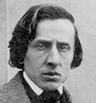
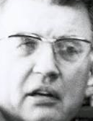
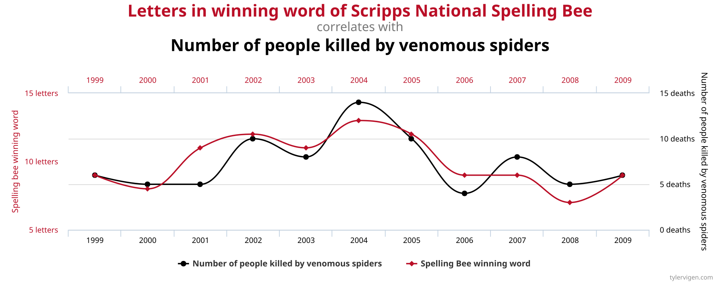
Instant culture
Is there a
correlation
here?
Have you ever heard of p-hacking?
Is it good? Bad?

Slide 55
Planning analyses (3)
In practice, you may somewhat deviate from your analysis plan and add to it (post hoc)
  See it as a baseline for your work…
  …but don’t push it just to get significant
  results (“p-hacking”)
  “If you torture the data long enough, it
  will confess to anything” (Coase R.)
After you have started working on your data, keep your final methodology and results somewhere:
  Cleaning and modifications in the data that you have made
  Analyses you have done
  Graphs, tables, etc.
Notes:
P-hacking can be:
Taking subsets of the data to get significant results
Only showing significant results
Include covariates to get significant results
Transforming the data to get significant results
Graph : spurious correlations website: https://tylervigen.com/spurious-correlations

Slide 56

R exercise (~1 hour)
TIME TO
WORK
Open the file C1E1.qmd in RStudio or Positron
Notes:
P-hacking can be:
Taking subsets of the data to get significant results
Only showing significant results
Include covariates to get significant results
Transforming the data to get significant results
Graph : spurious correlations website: https://tylervigen.com/spurious-correlations

Slide 57
What analyses?
Descriptive
  It’s a requirement, always describe your data
  This is useful both for the decision maker to understand your data, but especially for you
Exploratory
  Everything you do can be exploratory (it’s an attitude, more than a set of techniques)
  Dimensionality reduction techniques (principal components analysis, multiple correspondence analysis…) allow you to find latent factors (~underlying variables) from what you have
Modelling
  See next slides
Notes:
Interpretability vs. flexibility tradeoff: do you know what it is

Slide 58
What models?
The Interpretability vs. flexibility tradeoff
¿Qué es?

Slide 59
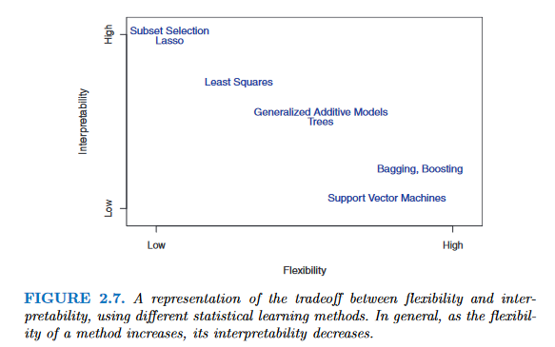
What models?
Interpretability vs. flexibility tradeoff
Decision makers want to know why you are getting the results you have
More flexible models, though more accurate, may be less valued because they are hard to understand
Sometimes, people just want coefficients from a regression model, or a single decision tree
From James GM. 2013. Introduction to statistical learning.
Notes:
Talk about trust:
Important with decision makers, clients
Data analysis is very much rhetorical. People don’t know if what you are doing is right. You use data analysis to show a point or prove a fact.
People will trust your work better when they can understand or at least know why you get the results that you have
Sometimes it is not about having the most complicated model, but the one that is most likely to convince people
Paradoxically : people trust LLMs a lot.

Slide 60
What models, but for my data? (1)
Always check the literature first, there may be specific estimation procedures to follow
In your research question, do you know what you have to estimate?
  Yes, I have a dependent variable which I must predict/for which I must find associated factors ➔ Supervised methods (regressions, trees, kNN, etc.)

Slide 61

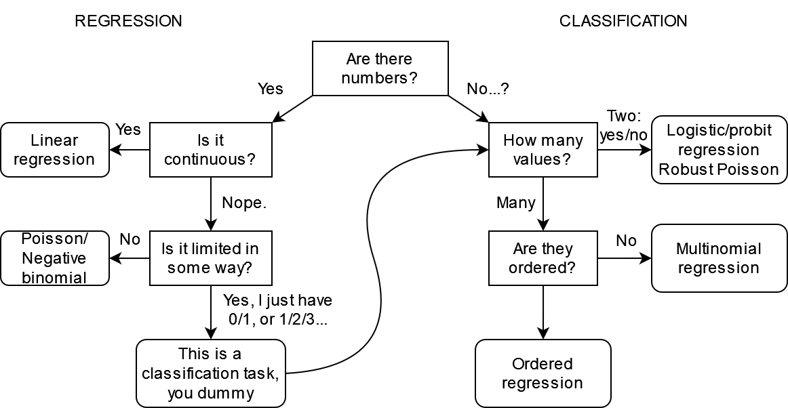

Supervised learning
Non-exhaustive list of commonly used linear models, and when to use them
Dep. variable
(i.e. is the data numerical?)
é
Note: you may use some ML models for both regression and classification, and may be robust to some specifications of the dependent variable

Slide 62
Supervised learning
Non-exhaustive list of commonly used linear models, and when to use them
Dep. variable
(i.e. is the data numerical?)
Note: you may use some ML models for both regression and classification, and may be robust to some specifications of the dependent variable

Slide 63
Some weird cases (1)
Watch out for limited dependent variables:
  Variables with limited range of values (e.g. scales from 1 to 5)
    In this case, don’t use a linear regression model
    Test ordered logit/probit models
    Or multinomial logit/probit if ordered logit assumptions are violated
  Censoring and truncation
    Censoring: you observe some floor or ceiling values in your dependent variables (e.g. annual income variable coded as >100,000€ when the true annual income is over this threshold).
    Truncation: same as censoring, but the entire observation is missing from the data when the threshold is hit
Notes:
Note: here censoring is in the dependent variable.
Censoring exists in survival analysis, but it refers to the observation window of participants in the study

Slide 64

Some weird cases (2)
You will encounter situations where you could have multiple candidate models
Example: length of stay in a hospital
  You could model that with a (robust) linear regression…
  But it’s strictly positive and discrete, so you could use a poisson/negative binomial regression
  Zero-inflated, if you have a lot of zeroes…
  Or consider it as time-to-event data, so use survival analyses methods (Accelerated Failure Time, Cox…)
POV: reviewer 2 about to nuke your whole career
Notes:
Model selection is also a choice. There may be not “best” model that represent what you are trying to understand.
Maybe your selection will be based on some metric, minimising some loss function (RMSE, MAE…). But why? Is a model that minimises some error truly representative of the underlying phenomenon you wanted to measure in the first place?

Slide 65
What models, but for my data? (2)
Always check the literature first, there may be specific estimation procedures to follow
Do you know what you have to estimate?
  Yes, I have a dependent variable which I must predict/for which I must find associated factors ➔ Supervised methods (regressions, trees, knn, etc.)
  No? ➔ Unsupervised methods (clustering)

Slide 66
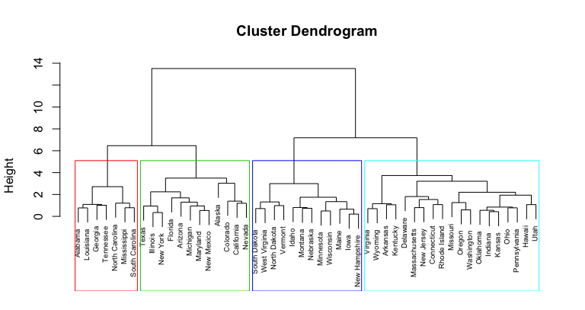
Unsupervised learning (1)
You don’t have a dependent variable, but you want to find groups in your data
Use clustering methods:
  Hierarchical clustering (in my experience,
  this has always yielded good results)
  K-means
  OPTICS, DBSCAN…
These projects are a lot more exploratory:
  You may propose multiple clustering methods
  There are criteria to find an optimal number of clusters…
  But don’t forget that the “best” clustering is the one that makes sense

Slide 67
Unsupervised learning (2)
Always check the characteristics of your clusters:
  Cross-tabulate your groups with the variables you used as inputs in the algorithm
  Or cross-tabulate with other variables that were not included as inputs
Good resources
  https://scikit-learn.org/stable/unsupervised_learning.html
  Cluster Analysis, 5th edition. https://cicerocq.wordpress.com/wp-content/uploads/2019/05/cluster-analysis_5ed_everitt.pdf
  FactoMineR package. http://factominer.free.fr/index.html

Slide 68
What models, but for my data? (3)
Always check the literature first, there may be specific estimation procedures to follow
Do you know what you have to estimate?
  Yes, I have a dependent variable which I must predict/for which I must find associated factors ➔ Supervised methods (regressions, trees, knn, etc.)
  No? ➔ Unsupervised methods (clustering)
There are other paradigms:
  Reinforcement learning
  Semi-supervised
  And others…

Slide 69
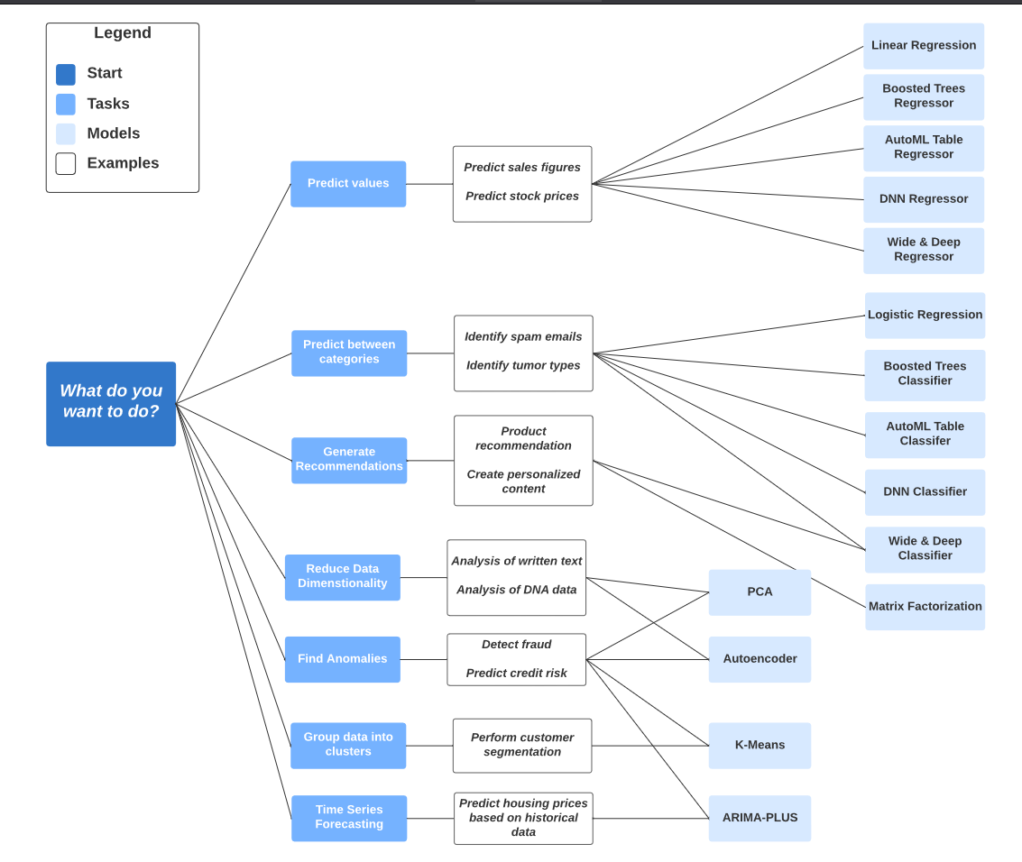
Google Big Query models cheat sheet
Non-exhaustive too, but it’s a useful cheat sheet depending on what you want to do

Slide 70
What variables to include?
Make ex-ante hypotheses, ideally based on:
  Existing literature
  Your own theoretical framework
You may add variables ex-post in your analyses (if your project allows it)
  But don’t mine for statistically significant associations (aka “p-hacking”), significant risk of false positives
Watch out for data leakage in variables (mostly in prediction):
  Information in historical data that should not be available when the model is run
  Different from data leakage in observations: information from test data inside the training data

Slide 71
What potential biases?
We will see that later in the course, but at that point you should ask yourself if they may be biases in your data or in your future analyses:
Endogeneity (simultaneity, omitted variables…)
Sample selection
Attrition
Psychological biases in surveys (desirability…)
Biases are hard to find, especially without seeing the data. You may find problems with your data as you go along in your project.

Slide 72
What to report?
Very important:
You don’t do analyses in a vacuum, you are doing all this work to show results
Find out what the client wants:
  Interpretable results? ➔ Use less flexible, more interpretable models
  Just good, accurate results? ➔ Use big black box models!
  Charts? An interactive dashboard?
Keep in mind these things take time, try to estimate how much time each thing will take (it’s hard even for seniors!)

Slide 73

How much resources?
Panicked data scientist who found out the hard way their data is too big
You may encounter hardware limitations
Hard to predict at beginner level
  Some data wrangling on medium sized data may be too much for your computer to handle
  Or a model (e.g. Random Forest) requires too much resources
How to solve?
  Ask for a beefier computer (easiest solution, but costly)
  Choose the right language & packages, write better code (cf chapter III)
  Cloud computing (for Big Data)

Slide 74
What programming language? (1)
As a beginner, if you have the choice, use the one you are the most comfortable with…
But you won’t always have the luxury of choosing:
  Some models may not be implemented (or implementable) in the language of your choosing
  The language may not be suited for what you want to do
  You may be working on virtual environments that only have specific programming languages

Slide 75
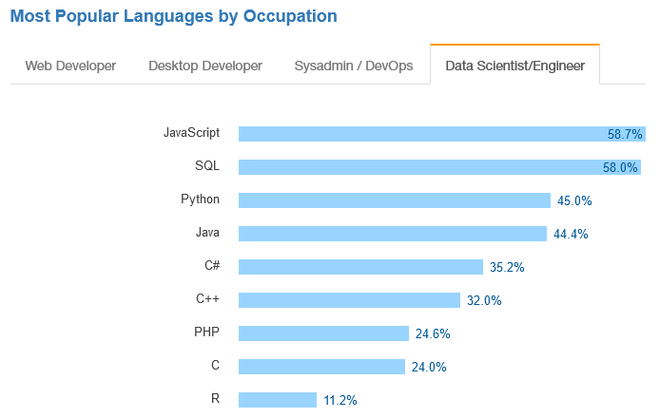





Popular languages
No real studies (afaik) on the most used languages among data scientists
Usually R/Python, with other languages being more situational
🤔
🤔🤔🤔
Stackoverflow Developer Survey 2017

Slide 76


Popular languages: the big ones
Python: good to learn, mostly used for Machine Learning
  Quite limited for stats compared to R (e.g. survey weighting, time series…)
  Outside of stats/ML, used in software engineering
R: great for stats, still OK for ML
  Use Python if you want to do Deep Learning or work on textual data
Some data scientists use both
  You could use one as your ‘main’ language, and the other one for specific use cases
SQL: great if you work on big databases
  If you use R, you can get away without knowing too much with dbplyr (automatically translates dplyr pipelines to SQL queries)

Slide 77

Popular languages: the paid ones
SAS
  Good investment to learn IF you work in the financial (banks) or healthcare sectors (Contract Research Organisations)
  These are high paying jobs; companies have difficulties hiring SAS users
  Not that useful elsewhere: syntax is clunky and obsolete, lack of commonly available tools in other IDEs (debugger, GitHub integration…), VERY expensive
  Opinionated take: your lecturer expects SAS usage to decrease as companies try to cut costs, there is a trend of migrating from SAS ➔ R.
Stata, SPSS, MatLab…
  Don’t bother, very rarely asked in job offers
  Some statistical software (e.g. Stata) may have econometric models still not developed in R, so their use may be situational

Slide 78



Rising languages?
Julia, Rust, Go…
Some popularity for these languages in the data science community (especially Julia)
  Considered to be very performant
  These languages are young (Julia came in 2012, while R/Python have been here for ~30 years), as are their ecosystems of packages
At this stage, nothing indicates that R/Python are falling out of favour
Nevertheless, keep an eye on emerging programming languages, one day you may have to do the switch

Slide 79

Some last ones
HTML & CSS
  Very useful if you want to make good-looking dashboards or websites
C/C++
  Many R functions are actually written in C or C++ (check out Rcpp package)
  If you write custom functions for time-critical applications, porting some of these functions to C++ can give you the speed you look for
  However, this is unlikely to concern you

Slide 80
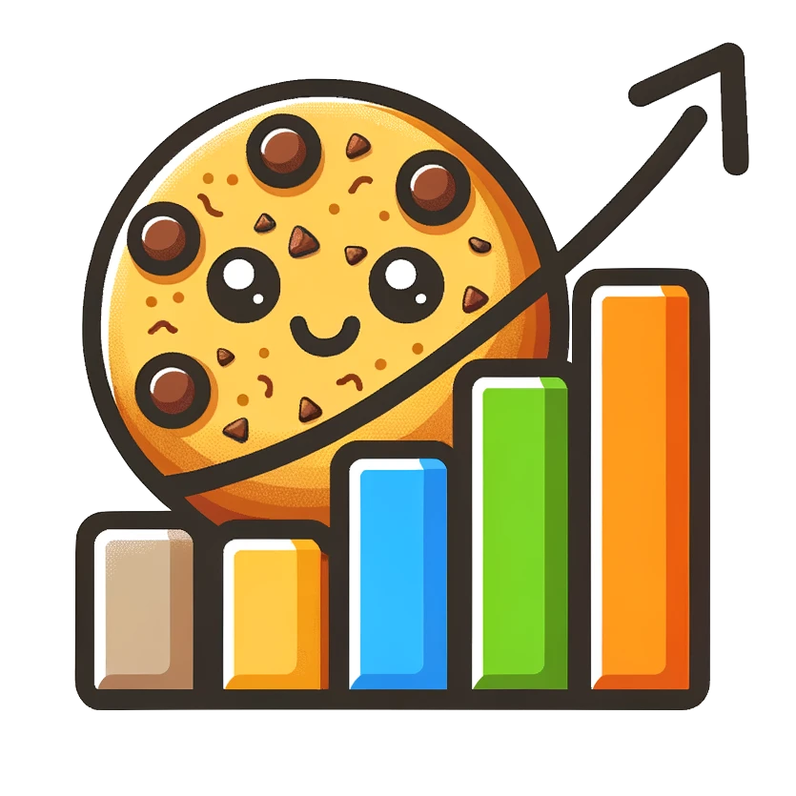
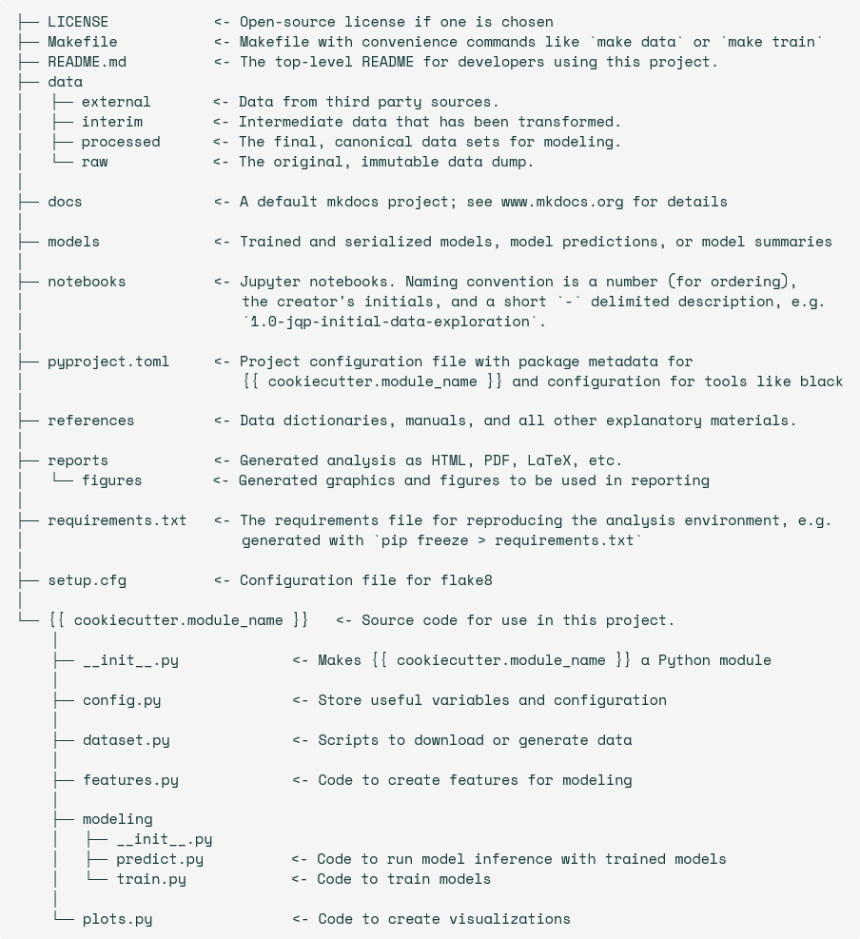
Cookiecutter Data Science
Python package that provides a basic project structure for data science work: https://cookiecutter-data-science.drivendata.org/
With other programming languages, just copy the folder structure
Useful when working with others: this is a commonly used skeleton for projects, and other data scientists won’t be lost when working on your project

Slide 81
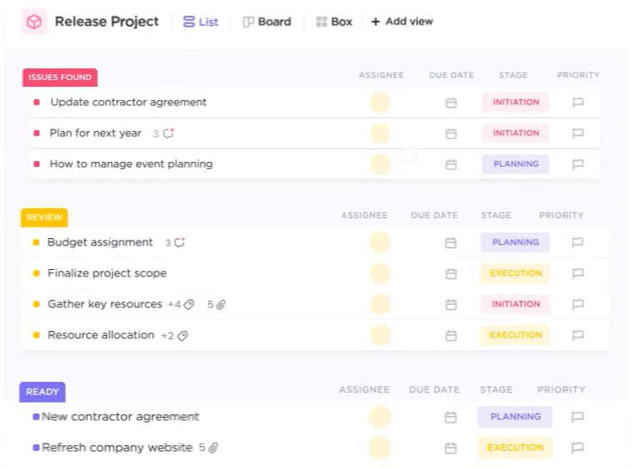
Working with others
Git (+ GitHub, GitLab…)
  Version control software: keeps track of all modifications in files of a project
  Great when working alone to keep a history of all changes you have made
  Great when working with others, to check new modifications, review their code…
Project management tools: Trello, ClickUp…
  Used to plan all steps in a project
  Very useful if you work on multiple projects to keep
  track of all you have to do
  Also great to check or report progress on tasks

